Slide 1
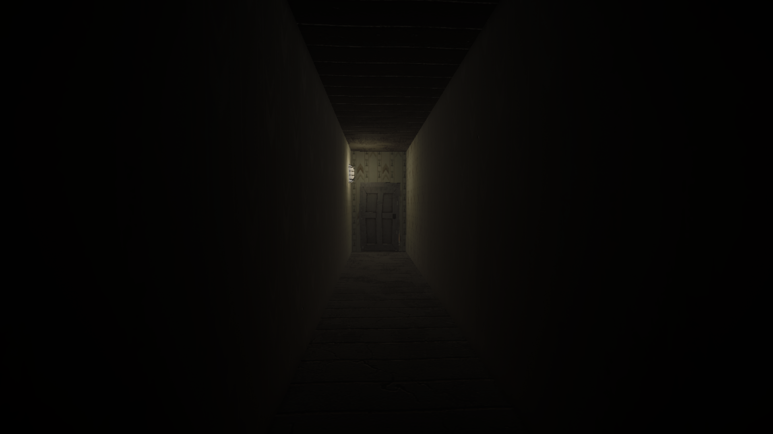

Slide 2
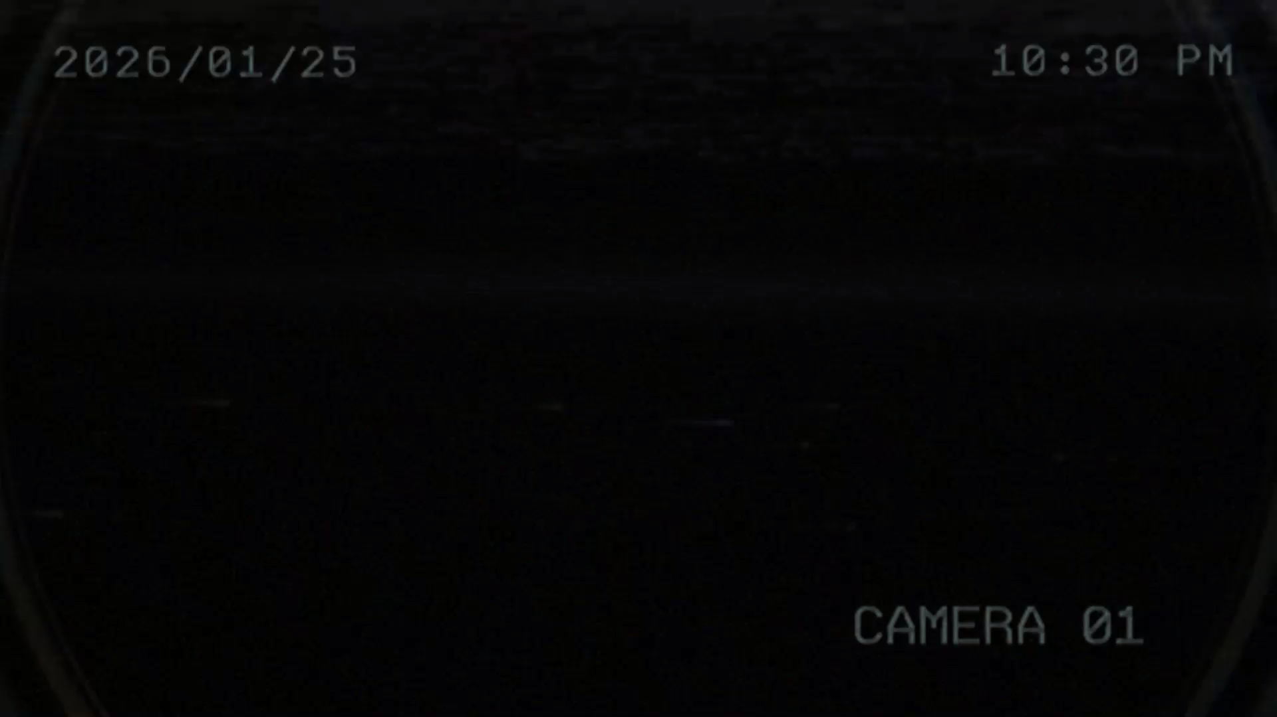

Slide 3
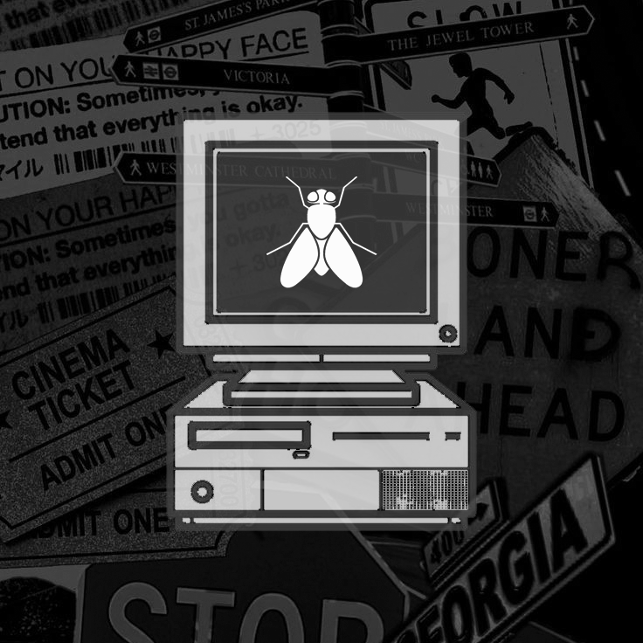
Recording 02:17
One Page Document_
Short Pitch
Recording 02:17 is a 3D first-person psychological horror game. You play as Beelzebub, a child trapped in repeating traumatic memories inside a surreal, glitching family house. Guided by swarms of flies that symbolize his trauma, the player explores the house and slowly uncovers the truth behind his father’s actions.
Game Concept
A linear, story-driven experience set in an ever-changing house where time loops around 02:17. Each repetition subtly alters the environment, revealing fragments of memory through objects, notes, and visual cues, as the player pieces together a tragic family story.
Genre & Platform
Genre: Psychological Horror / Narrative Exploration / First-Person Audience: +16 Platform: PC (Windows)

Slide 4
Recording 02:17
One Page Document_
Short Pitch
Recording 02:17 is a 3D first-person psychological horror game. You play as Beelzebub, a child trapped in repeating traumatic memories inside a surreal, glitching family house. Guided by swarms of flies that symbolize his trauma, the player explores the house and slowly uncovers the truth behind his father’s actions.
Game Concept
A linear, story-driven experience set in an ever-changing house where time loops around 02:17. Each repetition subtly alters the environment, revealing fragments of memory through objects, notes, and visual cues, as the player pieces together a tragic family story.
Genre & Platform
Genre: Psychological Horror / Narrative Exploration / First-Person Audience: +16 Platform: PC (Windows)
3C’s
Camera
First Person
Dark Vignette
Character
Silent protagonist
Ordinary human (no powers)
Trapped inside a memory loop
Emotion shown through animation, not dialogue
Controls
Standard WASD movement with slow walking speed

Slide 5
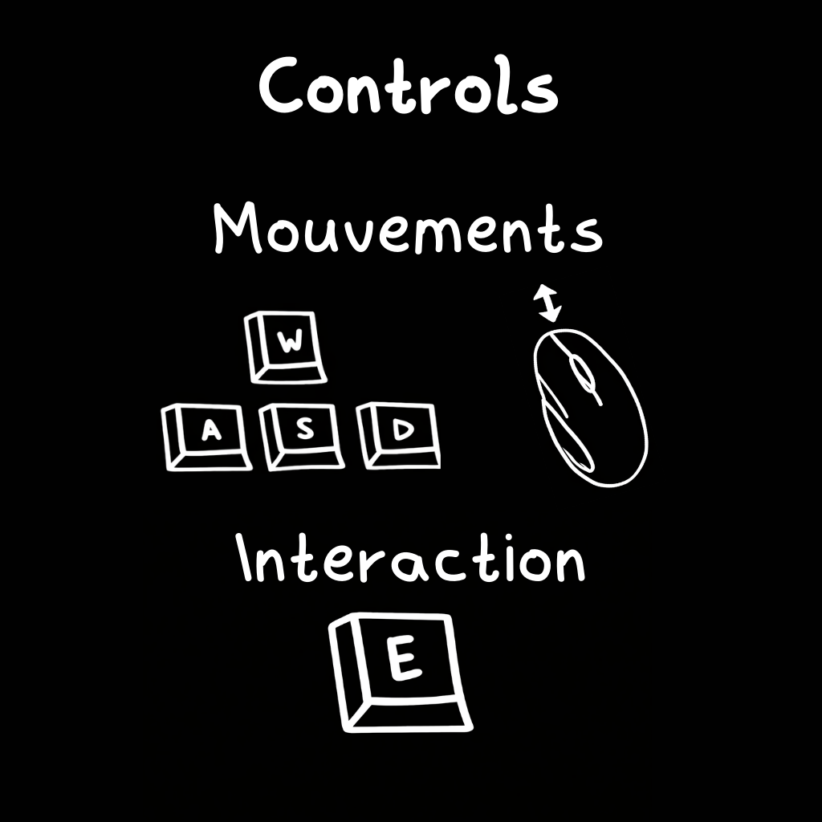
Recording 02:17
One Page Document_
Short Pitch
Recording 02:17 is a 3D first-person psychological horror game. You play as Beelzebub, a child trapped in repeating traumatic memories inside a surreal, glitching family house. Guided by swarms of flies that symbolize his trauma, the player explores the house and slowly uncovers the truth behind his father’s actions.
Game Concept
A linear, story-driven experience set in an ever-changing house where time loops around 02:17. Each repetition subtly alters the environment, revealing fragments of memory through objects, notes, and visual cues, as the player pieces together a tragic family story.
Genre & Platform
Genre: Psychological Horror / Narrative Exploration / First-Person Audience: +16 Platform: PC (Windows)

Slide 6
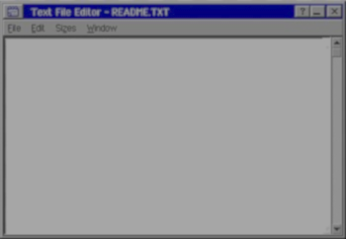
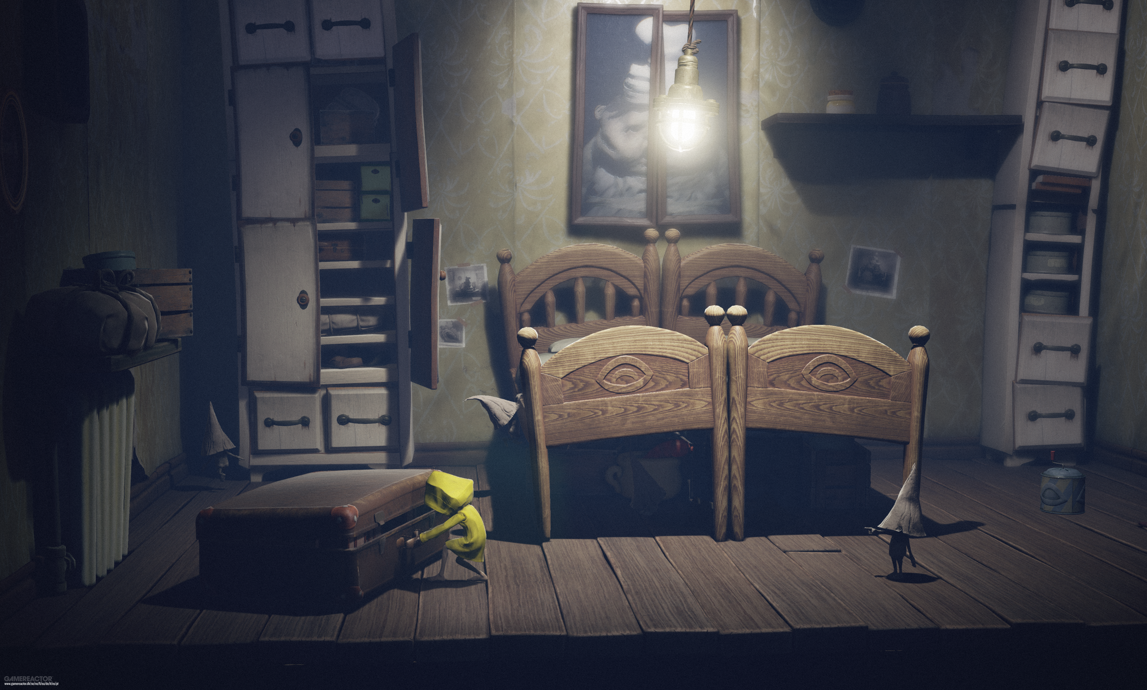
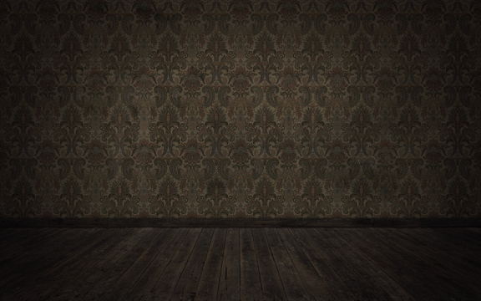
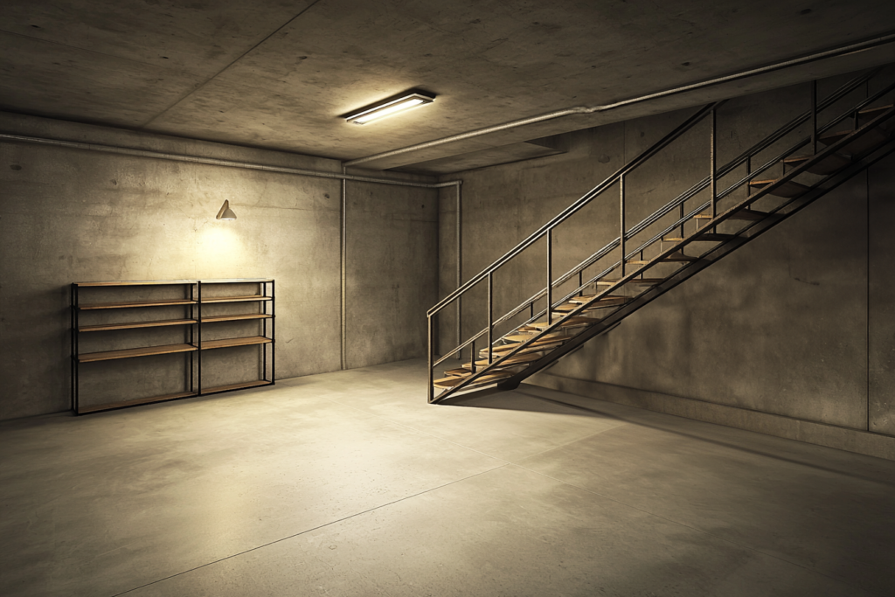
Short Pitch
Recording 02:17 is a 3D first-person psychological horror game. Players control Beelzebub, a child trapped in recurring traumatic memories inside a surreal, glitching family house. Swarms of flies hover and follow him, representing his identity and trauma, as he explores the house and gradually uncovers the truth about his father’s actions.
Game Concept
Linear narrative in first-person: Explore a surreal, ever-changing family house where each room reveals fragments of a tragic story.
Time loop mechanic: Events revolve around 02:17, repeating with subtle variations that alter the player’s perception of the environment and story.
Dynamic swarm of flies: Flies react to the player, symbolizing Beelzebub’s trauma and heightening psychological tension.
Story-driven exploration: The player experiences Beelzebub’s memories and slowly pieces together why his father killed his mother, uncovering the story through objects, notes, footage, and environmental cues.
Genre & Platform
Genre: Psychological Horror / Narrative Exploration / First-Person 3D Horror
Audience: +16
Platform: PC (Windows)
Story & Setting
Beelzebub is trapped in trauma, reliving distorted memory loops inside a surreal family house.
The house tells the story of his family’s tragedy, revealing details about his father’s actions and motivations.
Each loop allows Beelzebub to discover more about the events surrounding his mother’s death and confront the emotional weight of his memories.
Ambiance & Audio
Visuals: Dark, surreal, glitchy environments with moody lighting and particle-based swarms of flies.
Audio: Ambient creaks, whispers, buzzing flies, and eerie minimalist music enhance psychological tension and immersion.
One Page Document_
MoodBoard_

Slide 7
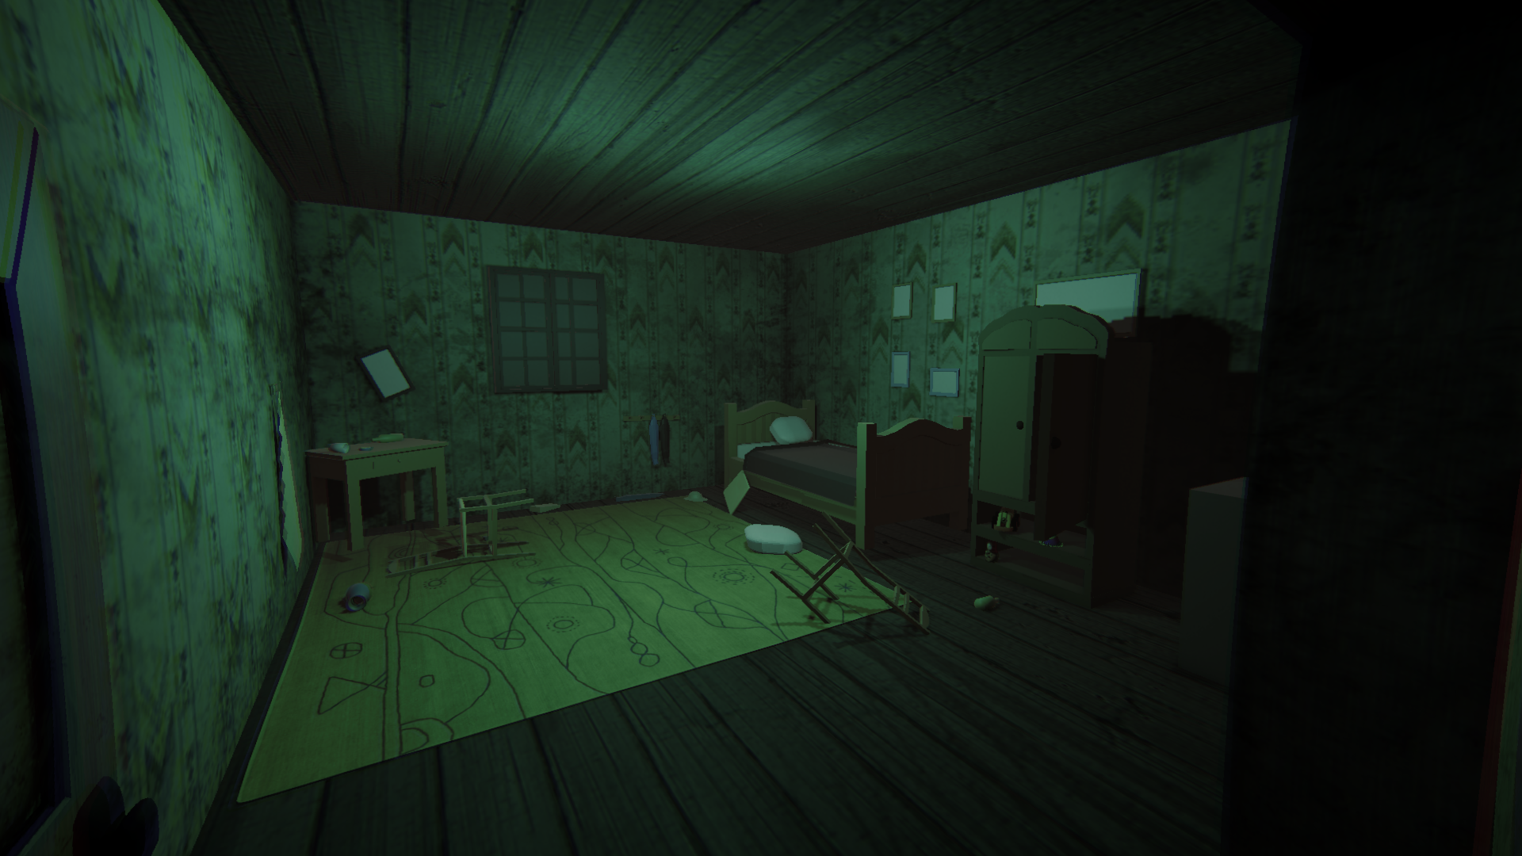
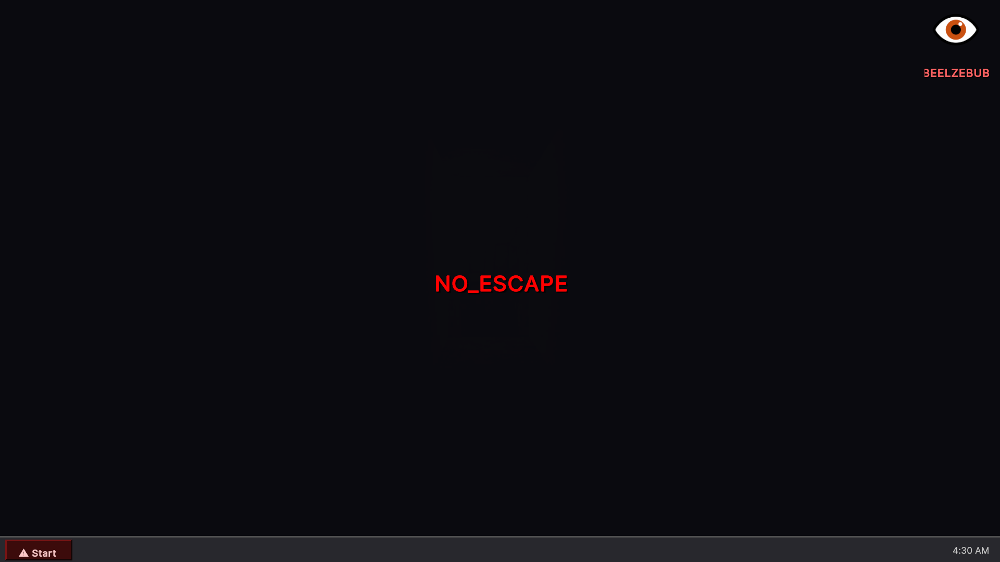
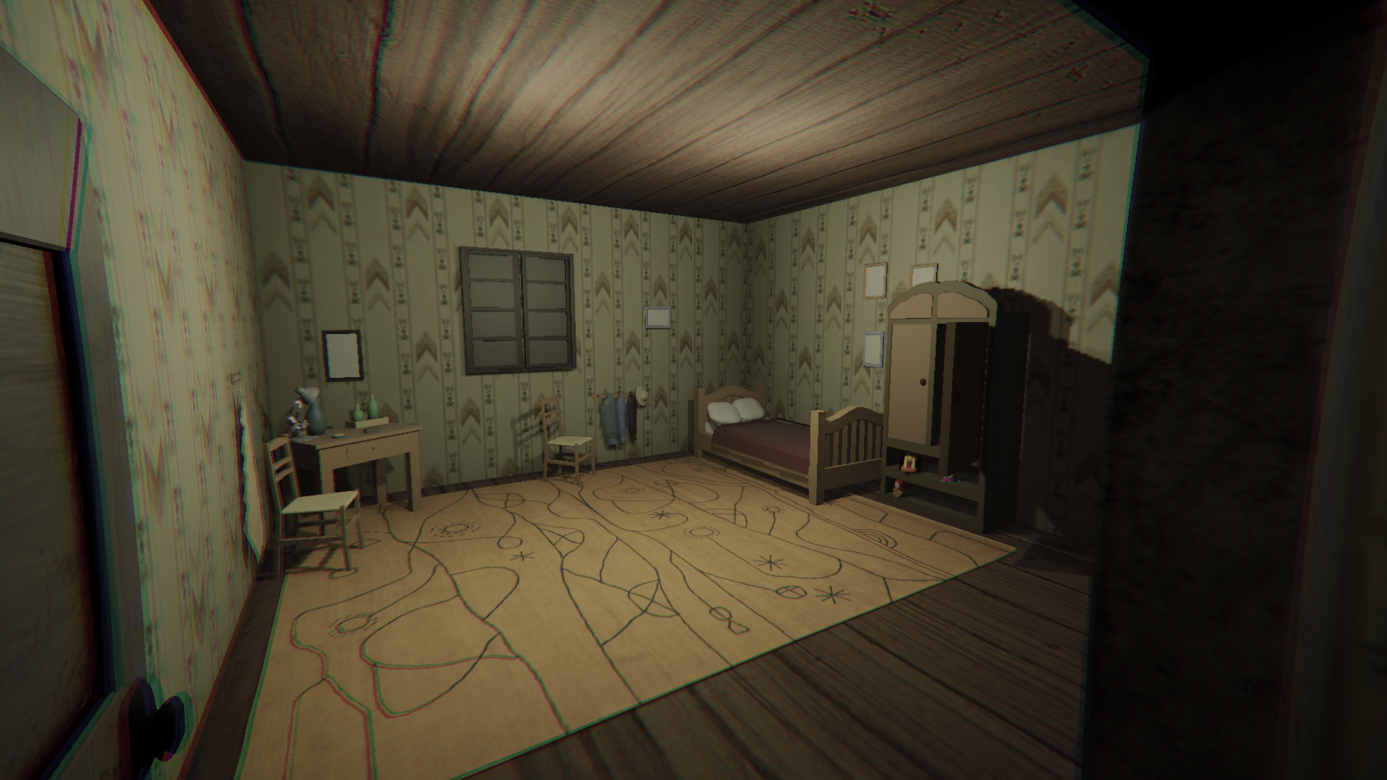
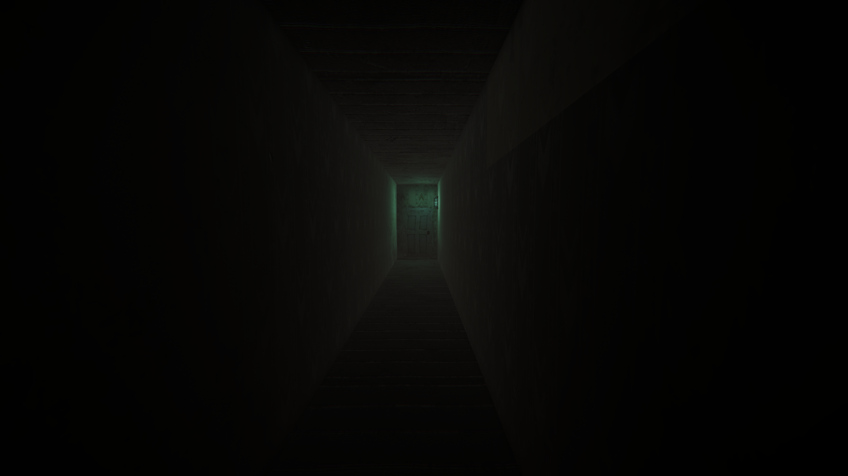
MoodBoard_
One Page Document_
Environment________
_______________

Slide 8

Environment________
MoodBoard_
_______________
Level Design_____________________________________________
Hallway 2
Room 1
Hallway 1
Hallway 3
Room 2
Start

Slide 9
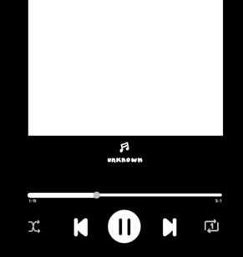
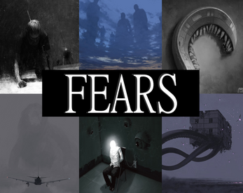
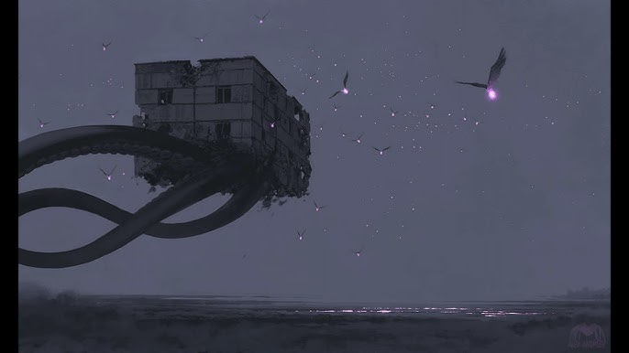
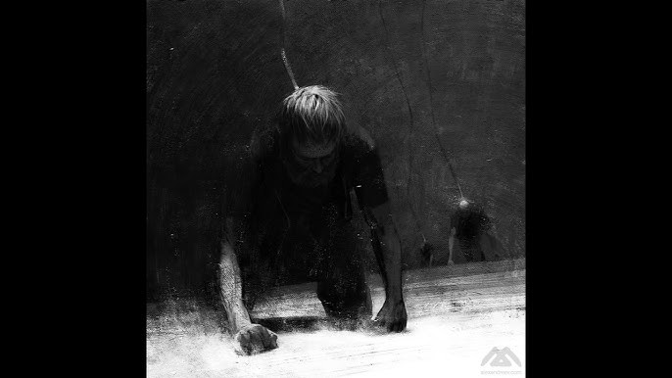
Environment________
MoodBoard_
_______________
Audio Design_____________________________________________
Apps__
Fl Studio
AudioMass
Devtrap - Electricity
Devtrap – Where is Home
Lullaby (our corrupted Electricity version)

Slide 10
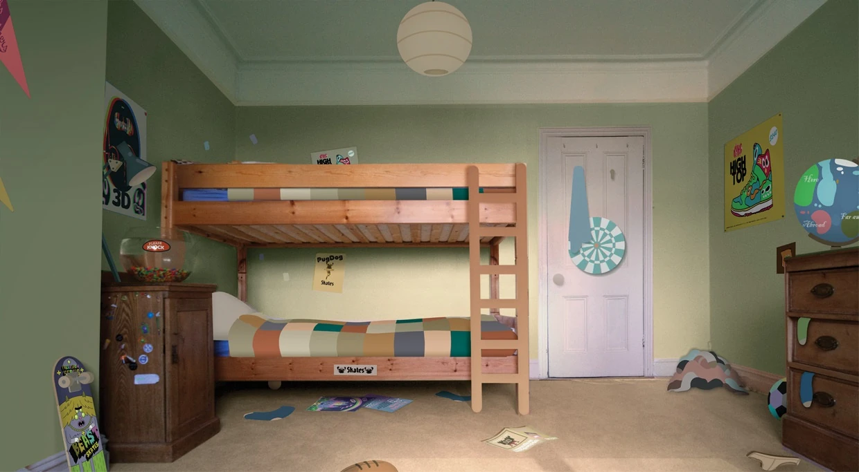
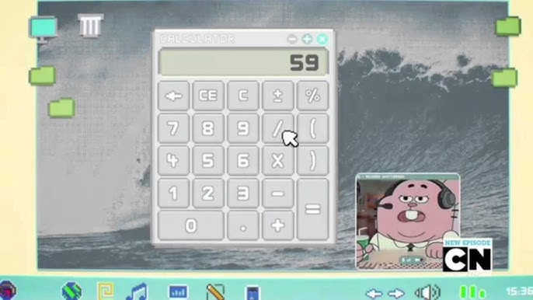
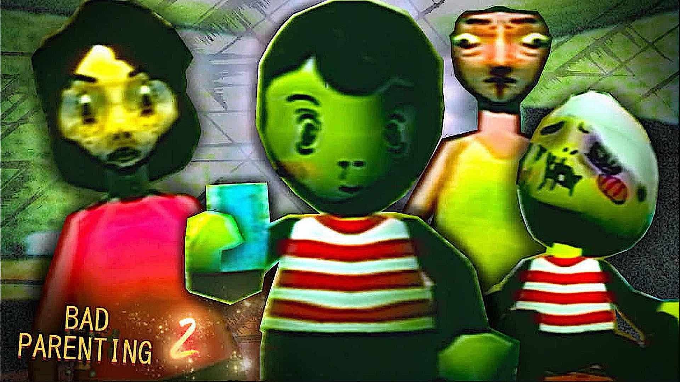
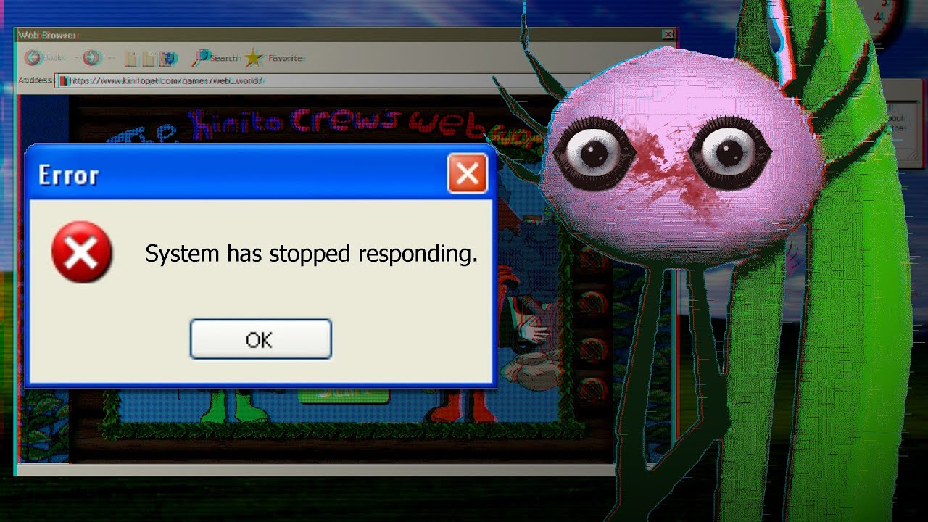
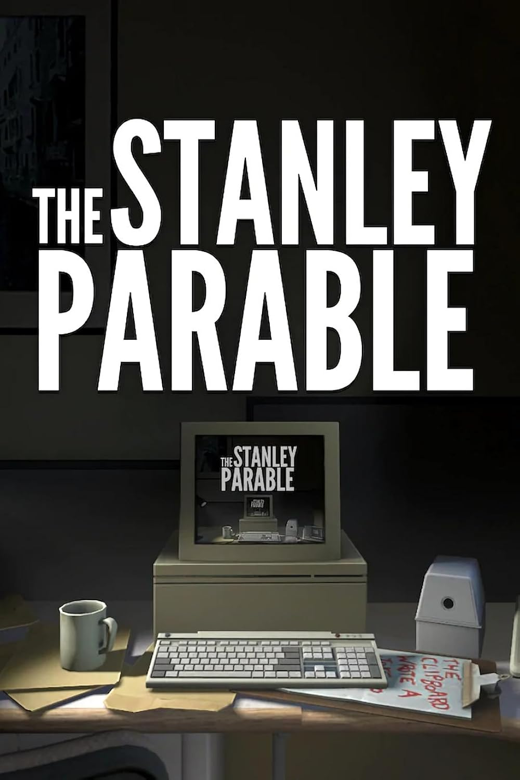
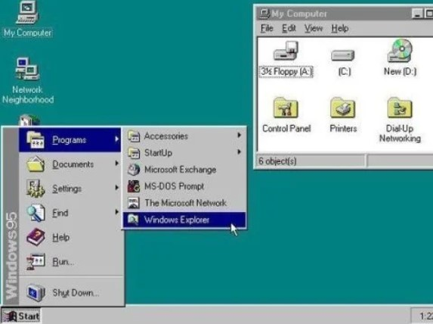
Apps__
Blender
AudioMass
MoodBoard_
Environment________
_______________
Devtrap - Electricity
Devtrap – Where is Home
Lullaby (our corrupted Electricity version)
References_______________________________________________

Slide 11




Apps__
Blender
AudioMass
MoodBoard_
Environment________
_______________
Devtrap - Electricity
Devtrap – Where is Home
Lullaby (our corrupted Electricity version)
Developing Tools____________________________________________________
Photoshop
Blender
VSCode
Unity

Slide 12
Apps__
Blender
AudioMass
MoodBoard_
Environment________
_______________
Devtrap - Electricity
Devtrap – Where is Home
Lullaby (our corrupted Electricity version)
Our
Team_____________________________________________________
Game Design
Game Dev
Game Artist
Game Sounds
Yassir Essabbahy
Driss Moussaoui
Yassir Essabbahy
Driss Moussaoui
Mohamed Bayrouk
Saad ElRhandouri
Mohamed Bayrouk
Saad ElRhandouri

Slide 13
Photoshop
Blender
VSCode
Unity
Thank You

